Slide 1
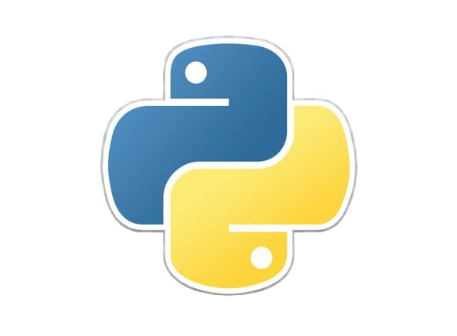
Introduction to Python Programming
Python 3.12 ~ 05.04.2024

Slide 2
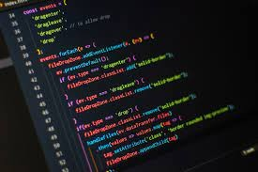
Introduction
Python, often dubbed as the "Swiss Army Knife" of programming languages, has emerged as a powerhouse in the world of technology.
Let’s delve into the world of Python programming, exploring its fundamental concepts, powerful features, and real-world applications.

Slide 3
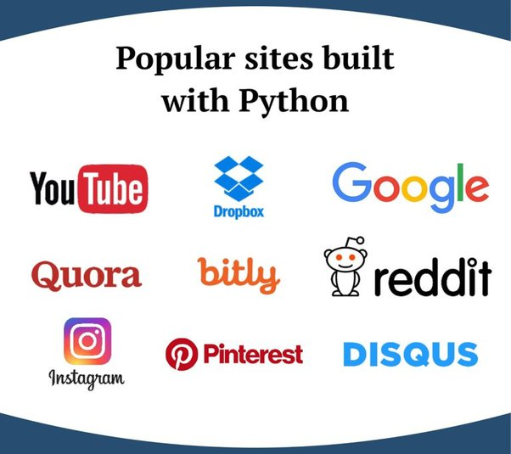

Brief overview of Python
Python is renowned for its versatility, being used across various domains such as web development, data analysis, artificial intelligence, scientific computing, and more.
It boasts a clean and readable syntax, making it an ideal choice for beginners and seasoned developers alike.
One of Python's strengths lies in its extensive standard library, offering a wide range of modules and packages for diverse functionalities.

Slide 4

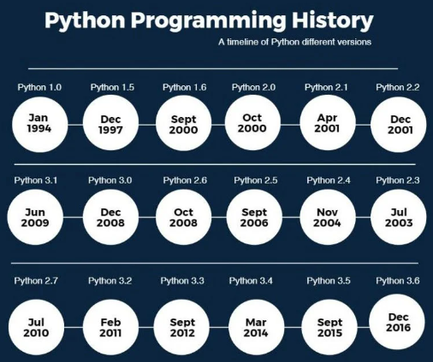
History and evolution
Python's journey began in the late 1980s when Guido van Rossum, a Dutch programmer, set out to create a language that emphasized simplicity and readability.
The first version of Python, Python 0.9.0, was released in February 1991, laying the foundation for what would become one of the most popular programming languages worldwide.
Python 2.x series, introduced in 2000, brought significant improvements and enhancements to the language, solidifying its position in the programming community.

Slide 5
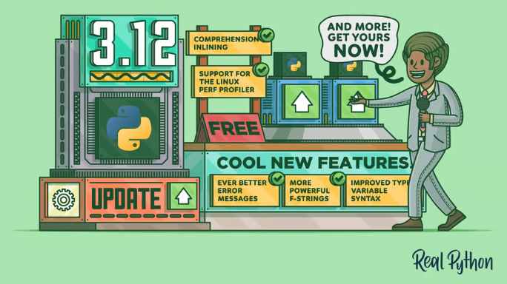
Python today (3.12 at the moment)
In 2008, Python 3.0, also known as "Python 3000" or "Py3k," was released, marking a major milestone in Python's evolution. While backward incompatible, Python 3.x aimed to address inconsistencies and modernize the language.
Since then, Python has continued to evolve, with regular releases introducing new features, optimizations, and enhancements to meet the changing needs of developers and industry trends.
Today, Python stands as a testament to the power of community-driven development, with a global network of contributors, enthusiasts, and users shaping its ongoing evolution and impact on the world of technology.

Slide 6
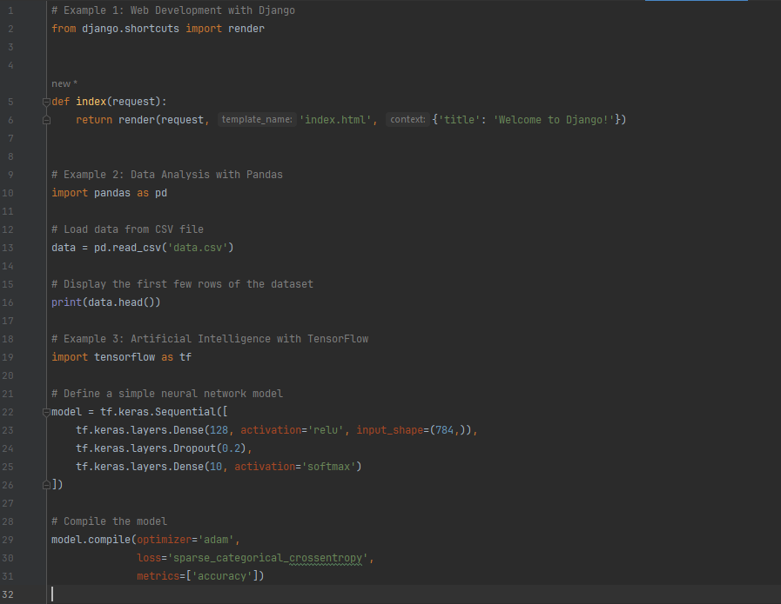
Popularity and use cases
Example 1 demonstrates Python's popularity in web development with Django, a high-level Python web framework. The code snippet shows a basic view function that renders an HTML template.
Example 2 showcases Python's use in data analysis with Pandas, a powerful data manipulation library. The code loads data from a CSV file and displays the first few rows of the dataset.
Example 3 illustrates Python's role in artificial intelligence and machine learning with TensorFlow, a popular machine learning framework. The code snippet defines a simple neural network model using TensorFlow's Keras API.

Slide 7
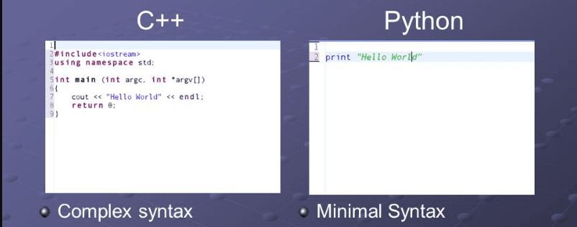
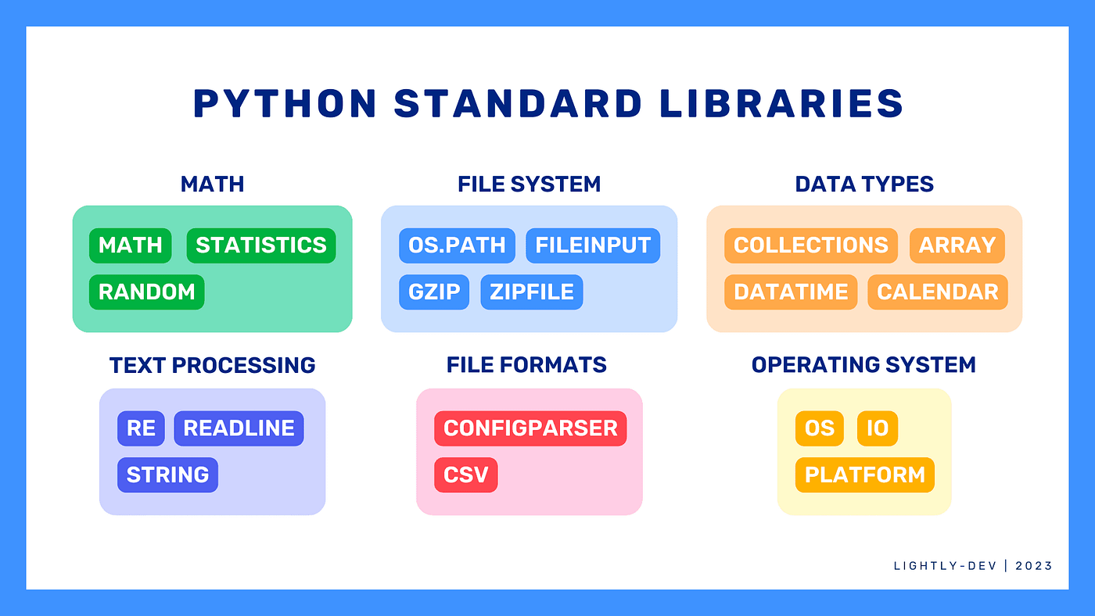
Why Python is a popular language for beginners and professionals alike
Clear and Readable Syntax: Python's syntax is designed to be intuitive and easy to understand, allowing beginners to grasp programming concepts quickly without sacrificing readability for professionals working on large-scale projects.
Extensive Standard Library: Python comes with a vast standard library that provides ready-to-use modules and packages for various tasks, reducing development time and effort for both beginners and professionals.

Slide 8
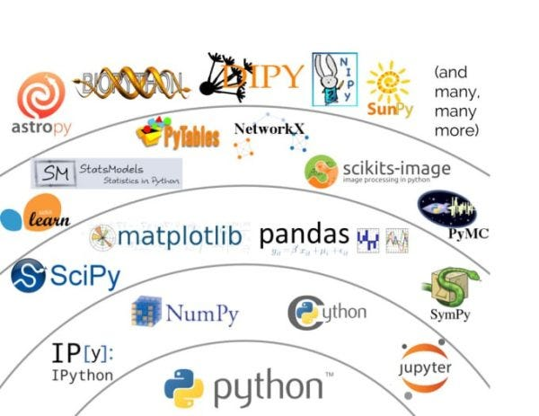
Why Python is a popular language
Abundance of Third-party Libraries: Python boasts a rich ecosystem of third-party libraries and frameworks tailored to different domains, such as web development, data science, machine learning, and more, empowering professionals to tackle diverse challenges efficiently.
Community Support and Documentation: Python has a thriving community of developers, educators, and enthusiasts who actively contribute to its development, provide assistance through forums and communities, and maintain extensive documentation, ensuring beginners and professionals have access to resources and support at every stage of their journey.

Slide 9
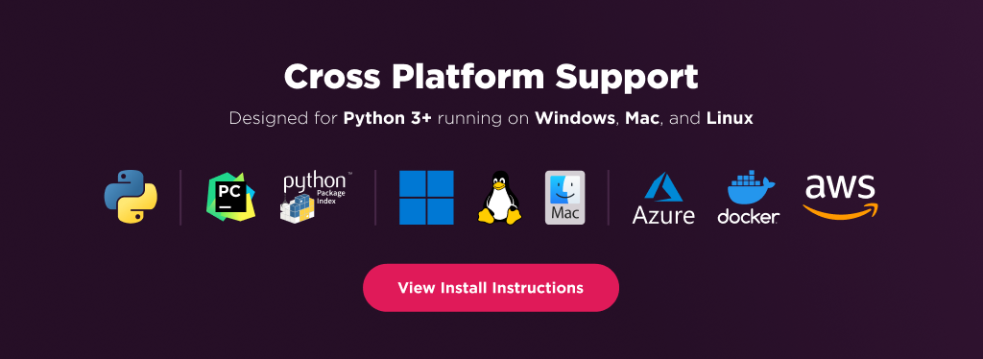

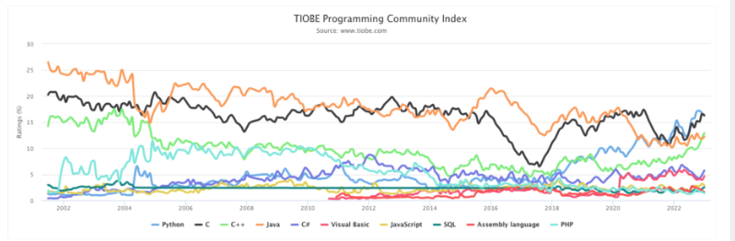
Why Python is a popular language
Cross-platform Compatibility: Python's cross-platform compatibility allows developers to write code once and run it on multiple platforms, including Windows, macOS, and Linux, enhancing productivity and flexibility for professionals working in heterogeneous environments.
Scalability and Performance: Python's scalability and performance have improved significantly over the years, thanks to optimizations and enhancements in the language and its implementations, making it suitable for building scalable and high-performance applications for professionals tackling complex problems.

Slide 10
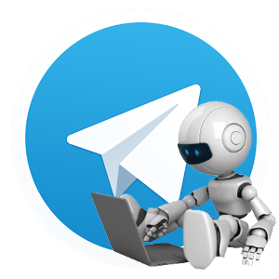
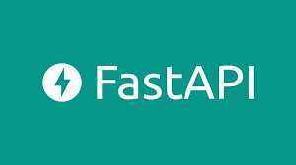
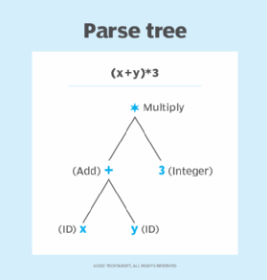
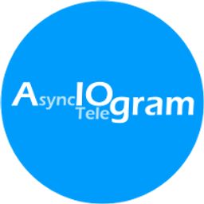
Why do I use python and what for
For web backend and parsing
For programming telegram bots
Simple commands

Slide 11
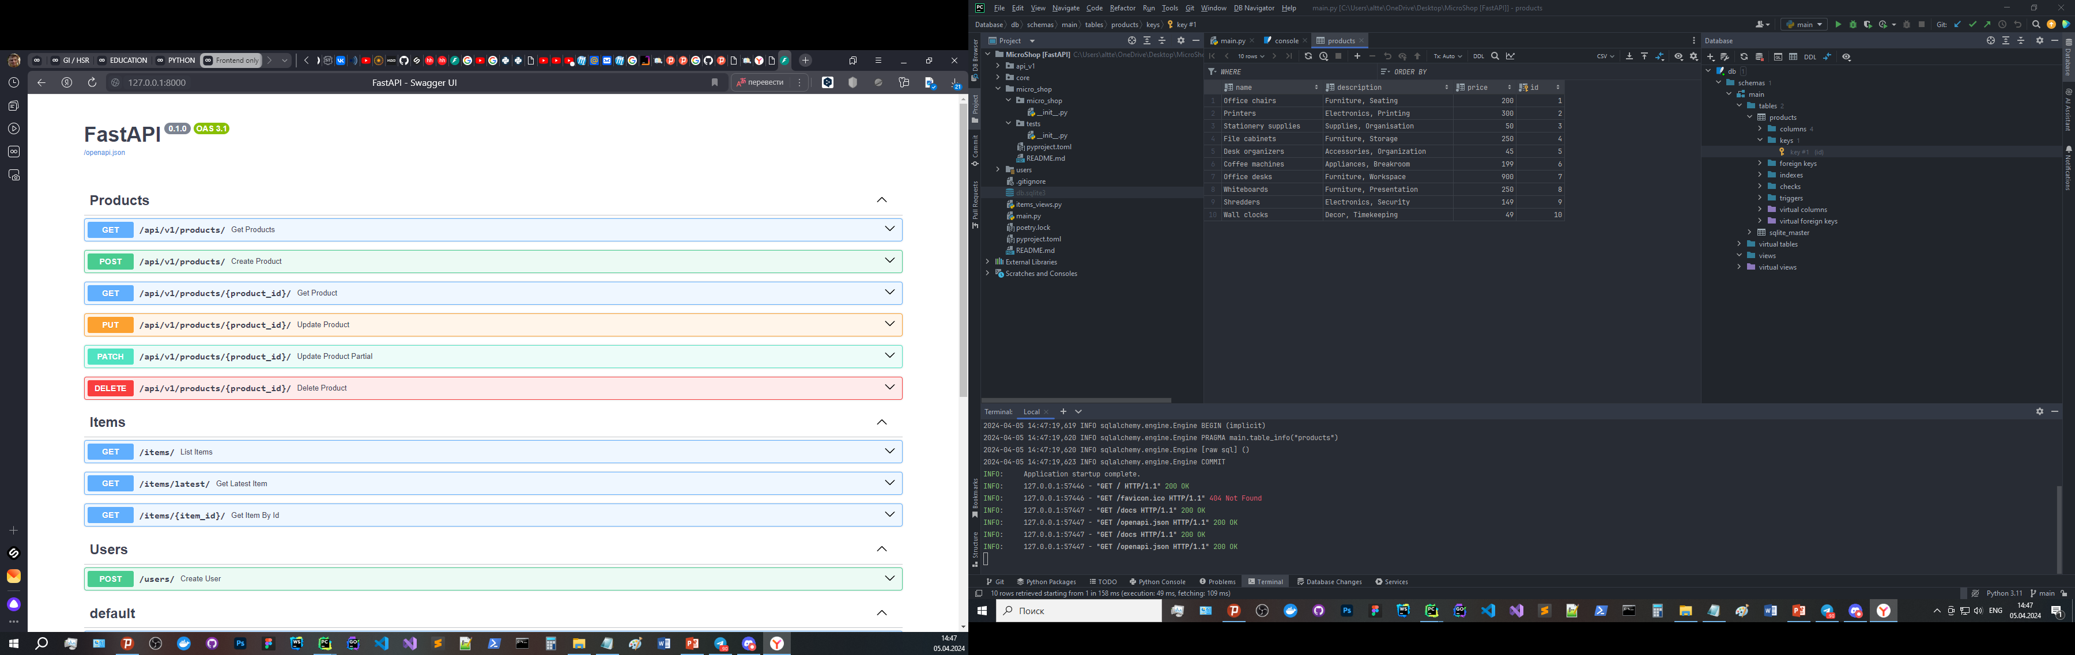
web backend
FastAPI + SQLAlchemy 2.0

Slide 12
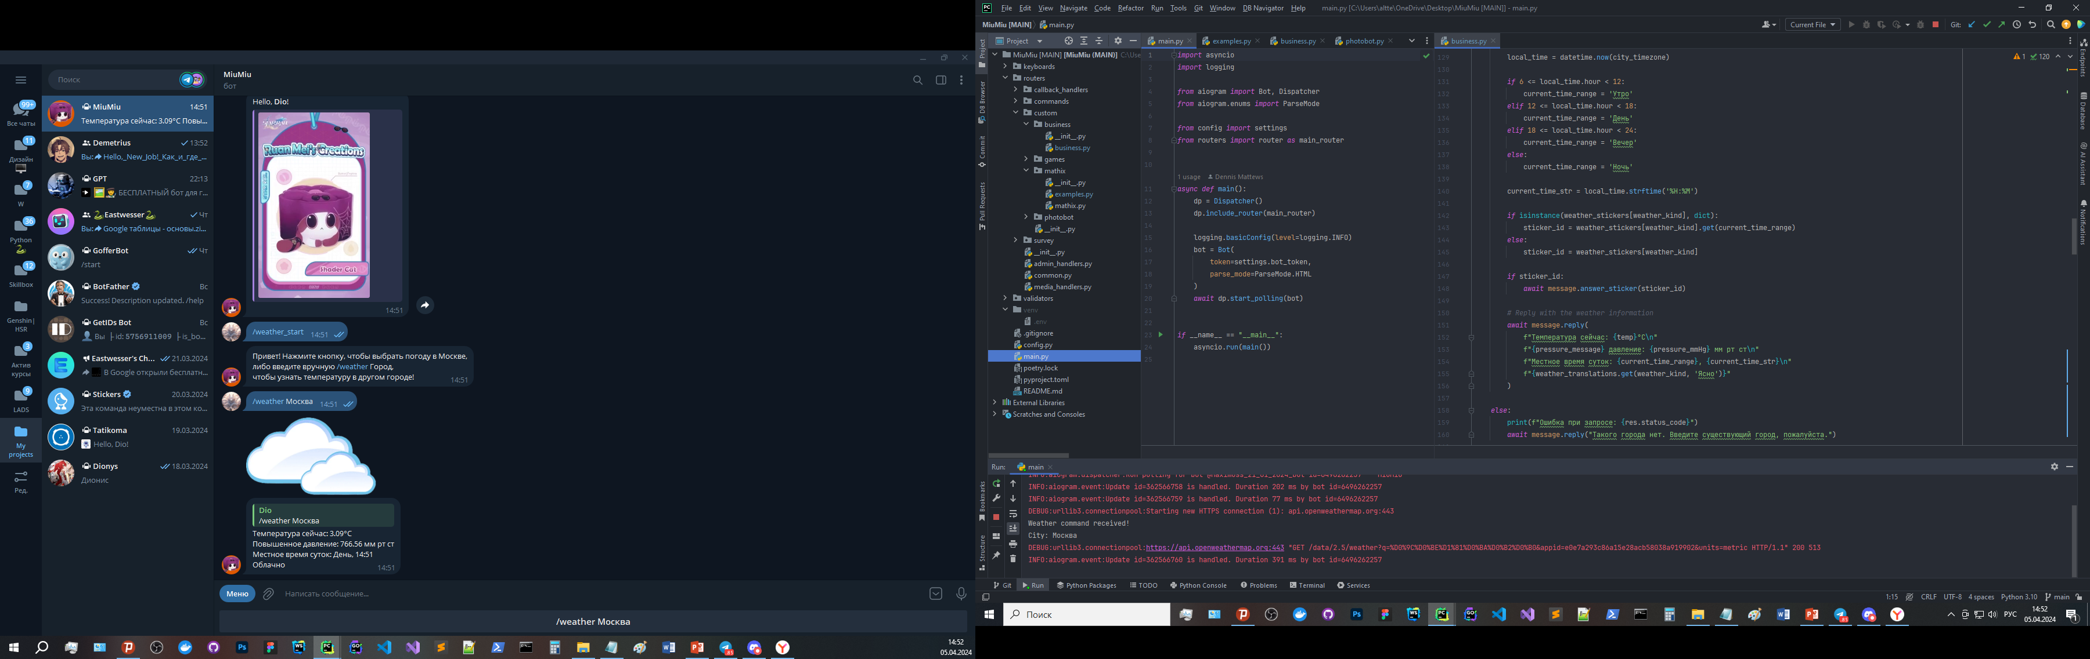
programming telegram bots

Slide 13
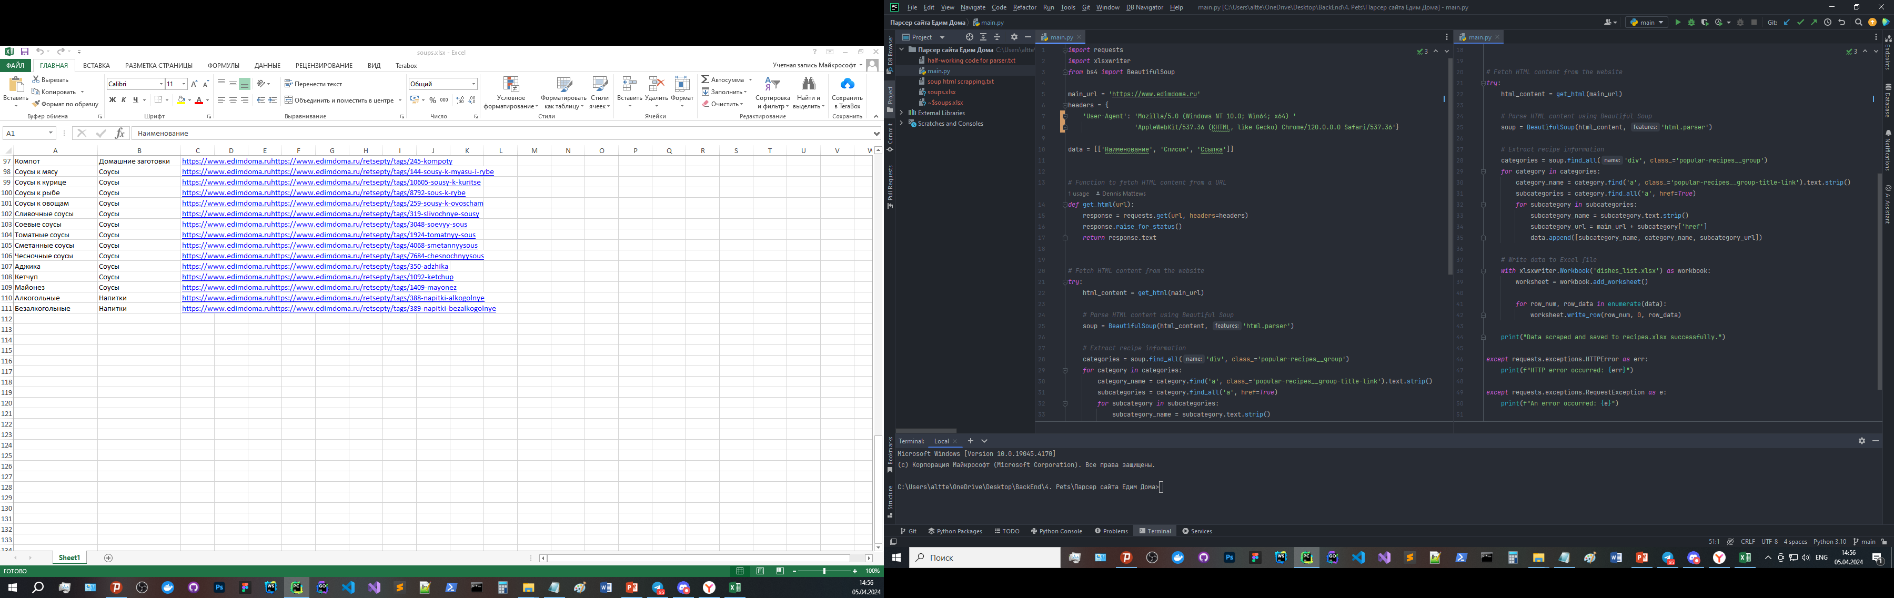
Simple commands and parsing
Also, the library pip install you-get Command: you-get https://youtu.be/b4ismAip5Fg?si=1Eva-JF5A9HKYLei - allows you to download videos via links

Slide 14

Introduction to Python data types, methods, functions, loops, and Object-Oriented Programming (OOP)

Slide 15
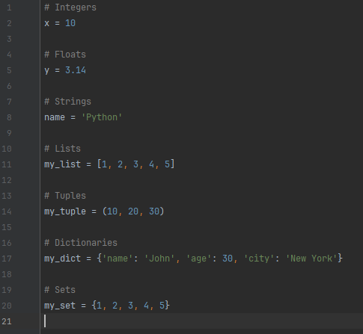
Python Data Types
Data Types: Python offers various built-in data types such as integers, floats, strings, lists, tuples, dictionaries, and sets, enabling developers to represent and manipulate different kinds of data effectively.
Integers (int): Whole numbers without any decimal point.
Floats (float): Numbers with a decimal point or numbers written in scientific notation.
Strings (str): Sequences of characters enclosed within single, double, or triple quotes.
Tuples (tuple): Immutable ordered collections of items, similar to lists but cannot be modified after creation.
Lists (list): Ordered collections of items, mutable and dynamic in size.
Dictionaries (dict): Unordered collections of key-value pairs, where each key maps to a corresponding value.
Sets (set): Unordered collections of unique elements, useful for mathematical operations such as union, intersection, and difference.
*Can/cannot be changed

Slide 16
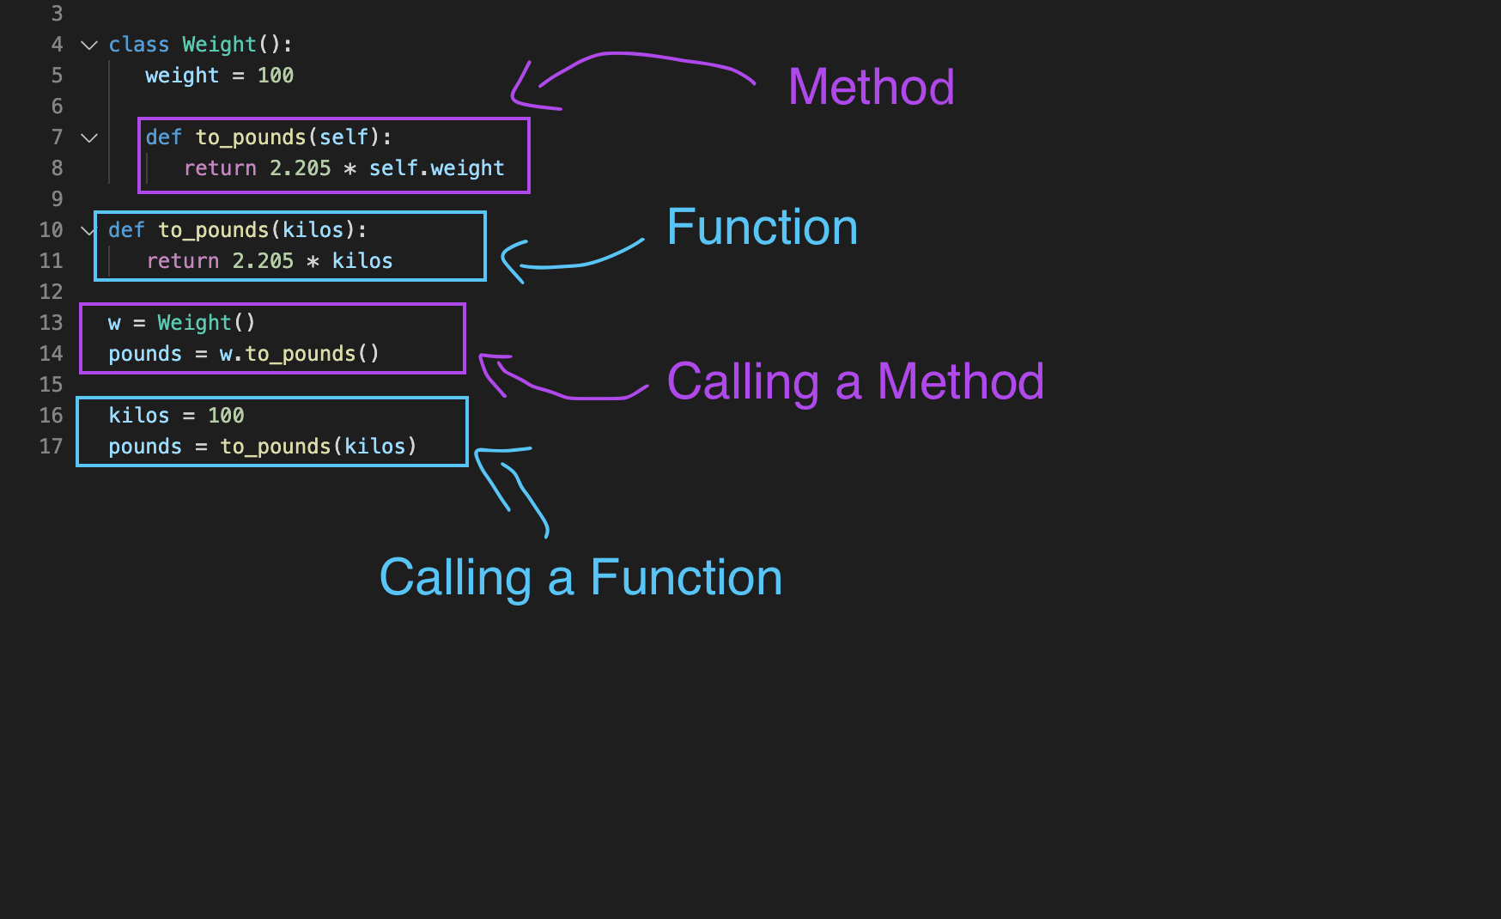

Methods and Functions

Slide 17
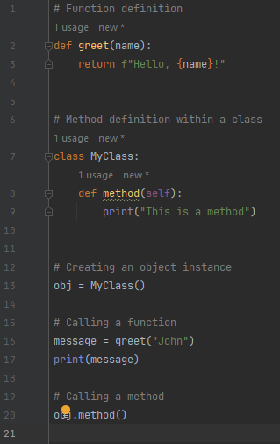
Difference between methods and functions
Functions:
Functions are standalone blocks of code that can be called independently, regardless of any object.
They are defined using the def keyword followed by a function name and optional parameters.
Functions can accept input arguments and return output values.
They promote code reusability and modular programming, enabling developers to organize code into smaller, manageable units.

Slide 18
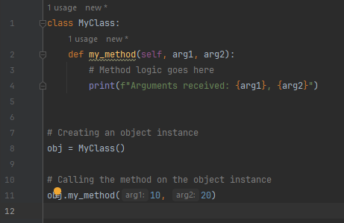
Difference between methods and functions
Methods:
Methods are functions that are associated with objects or classes and operate on the data contained within those objects.
They are defined within a class definition and are accessed via object instances or the class itself.
Methods implicitly receive the object instance (self) as the first parameter, allowing them to access and manipulate object attributes.
Methods can modify the state of the object they belong to and may or may not return a value.

Slide 19
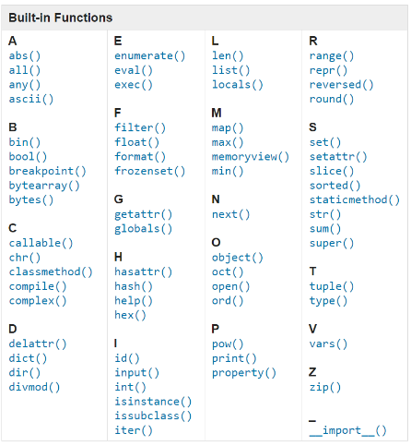
Explanation of built-in methods and functions in Python
Python comes with a rich set of built-in methods and functions that provide powerful tools for performing common tasks and operations.
Built-in methods are specific to certain data types or objects and are called directly on those objects to manipulate or retrieve data.
Built-in functions, on the other hand, are globally available and can be used to perform a wide range of operations on different types of data.
Understanding and leveraging these built-in methods and functions can significantly enhance productivity and streamline development workflows in Python.

Slide 20
Explanation of built-in methods and functions in Python
Example Built-in Methods:
append(): Adds an element to the end of a list.
upper(): Converts a string to uppercase.
sort(): Sorts the elements of a list in ascending order.
keys(): Returns a view of all keys in a dictionary.
Example Built-in Functions:
len(): Returns the length of a sequence (e.g., string, list, tuple).
range(): Generates a sequence of numbers within a specified range.
sum(): Calculates the sum of all elements in a sequence.
max(): Returns the maximum value from a sequence.

Slide 21
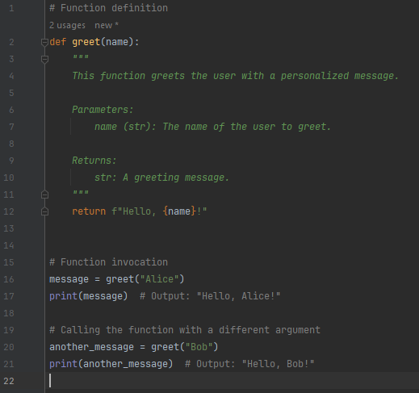
How to define and use custom functions
Custom functions in Python allow developers to encapsulate reusable blocks of code and give them descriptive names, enhancing code readability and maintainability.
Defining a custom function involves specifying the function name, parameters (if any), and the block of code to be executed when the function is called.
Once defined, custom functions can be invoked multiple times with different arguments, promoting code reusability and modularity.

Slide 22
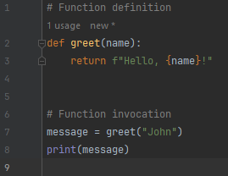
Let's explore the steps to define and use custom functions in Python:
Function Definition:
Use the def keyword followed by the function name to define a custom function.
Specify any parameters within parentheses, if required.
Write the block of code to be executed within the function body.
Function Invocation:
Call the custom function by its name followed by parentheses.
Pass any required arguments within the parentheses, if specified.
The function executes the defined code block and may return a value, if specified using the return keyword.

Slide 23
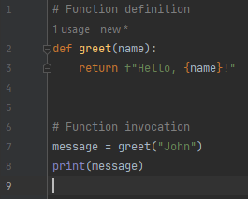
Explanation:
In this example, a custom function named greet is defined to accept a name parameter and return a greeting message.
The function is then invoked with the argument "John", and the returned message is printed to the console.
Custom functions empower developers to encapsulate logic, promote code reuse, and enhance the maintainability of Python codebases.

Slide 24
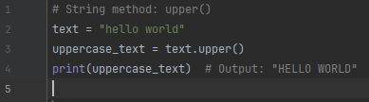
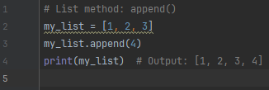
Examples demonstrating methods and functions
Methods and functions play a vital role in Python programming, enabling developers to perform specific tasks efficiently and effectively. Let's explore some examples showcasing the usage of methods and functions in different scenarios:
String Methods:
String methods are built-in functions specifically designed to manipulate strings. These methods can perform operations such as converting case, splitting, joining, and searching within strings.
List Methods:
List methods provide various functionalities for working with lists, such as adding or removing elements, sorting, and searching.

Slide 25
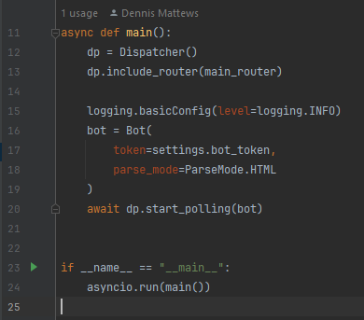
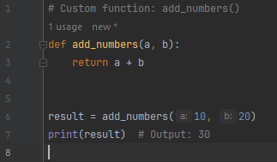
Custom Functions:
Custom functions are user-defined blocks of code that encapsulate specific logic and can be called multiple times with different inputs.

Slide 26
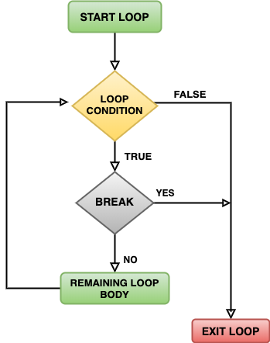
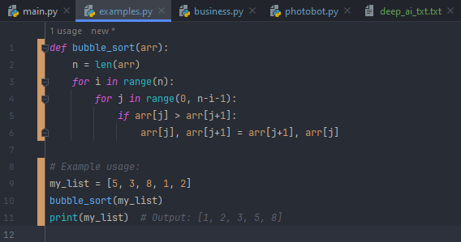
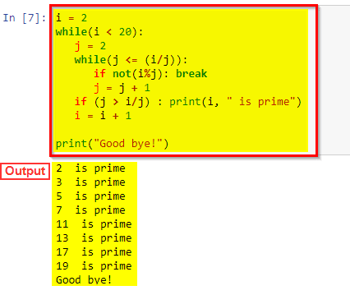
Loops and Control Structures

Slide 27
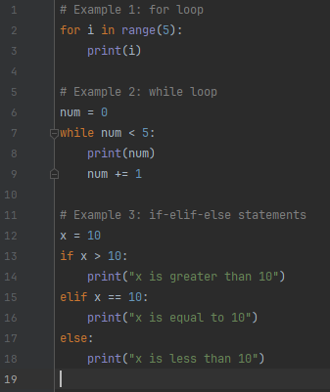
Introduction to loops (for, while) and conditional statements (if, elif, else)
Loops and conditional statements are essential control structures in Python that allow developers to execute code repeatedly or conditionally based on certain criteria.
Loops:
Loops are used to iterate over a sequence of elements or execute a block of code repeatedly until a specified condition is met.
Python supports two main types of loops: for loops and while loops, each with its own syntax and use cases.
Conditional Statements:
Conditional statements allow developers to execute different blocks of code based on specific conditions.
The primary conditional statements in Python are if, elif (short for "else if"), and else.
These statements help control the flow of the program by evaluating conditions and executing the appropriate code block accordingly.

Slide 28
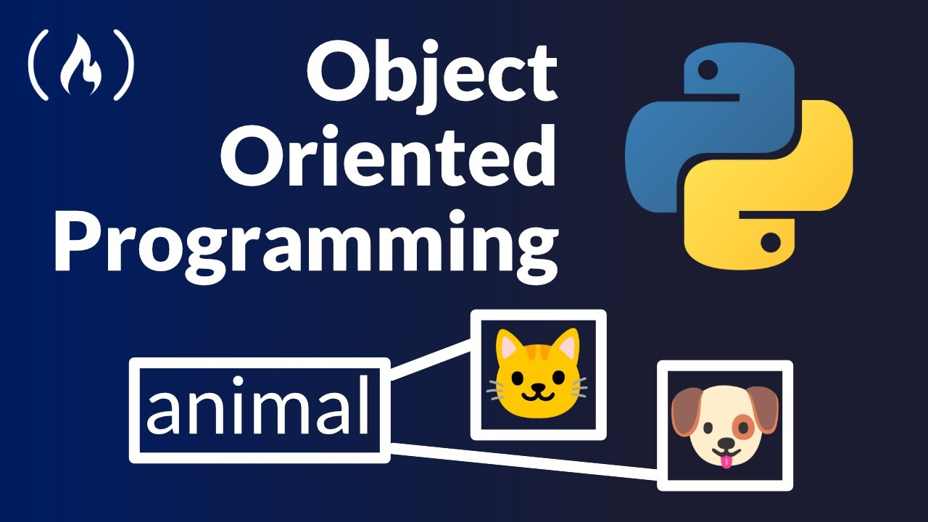
Object-Oriented Programming (OOP)

Slide 29
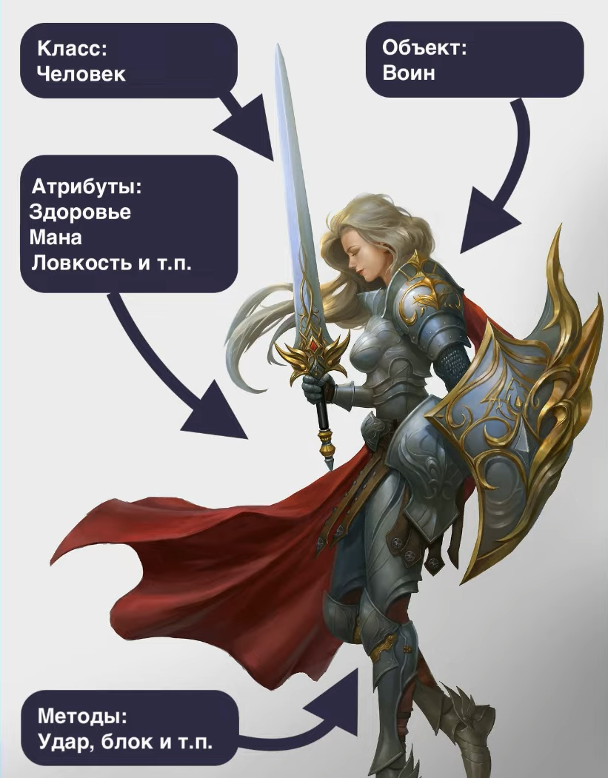
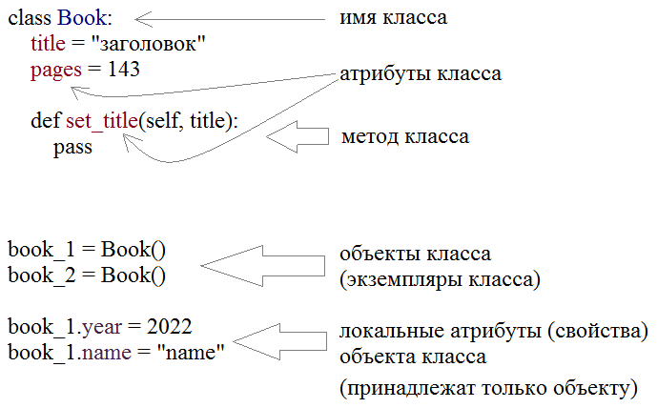
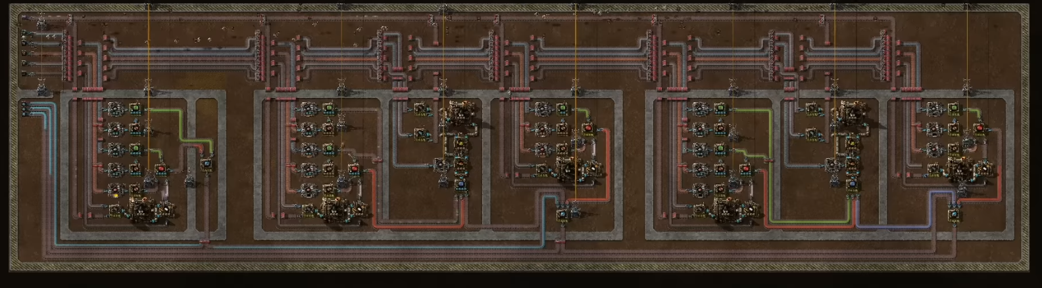
Explanation of how OOP is implemented in Python
Object-oriented programming (OOP) is implemented in Python through classes and objects, allowing for the creation of reusable and modular code structures.
Python supports key OOP principles such as encapsulation, inheritance, and polymorphism, enabling developers to build scalable and maintainable applications efficiently.

Slide 30
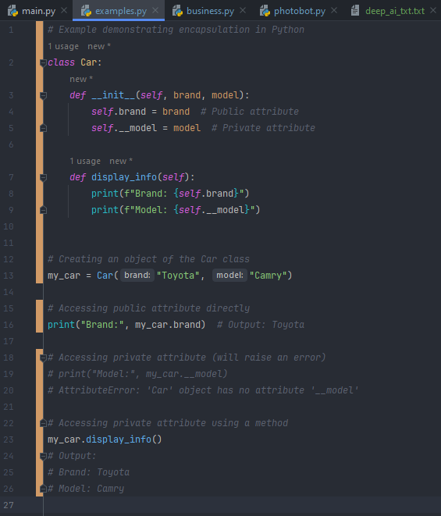
Encapsulation
Encapsulation Explanation:
In the example, we define a Car class with public (brand) and private (__model) attributes.
The __init__() method initializes the object's attributes, and the display_info() method displays information about the car.
Access to the private attribute __model is restricted outside the class, preventing direct modification or access.
Encapsulation helps maintain data integrity and prevents unintended modifications to the internal state of objects.
Encapsulation is a fundamental principle in object-oriented programming that involves bundling data (attributes) and methods (functions) that operate on the data into a single unit (class), while restricting access to the inner workings of the class from outside.
In Python, classes and objects serve as the primary mechanisms for implementing encapsulation, providing a way to organize code and control access to data and methods.
Classes and Objects:
Classes are blueprints or templates for creating objects, defining the structure and behavior of the objects.
Objects are instances of classes, representing specific entities or instances in the program's domain.

Slide 31
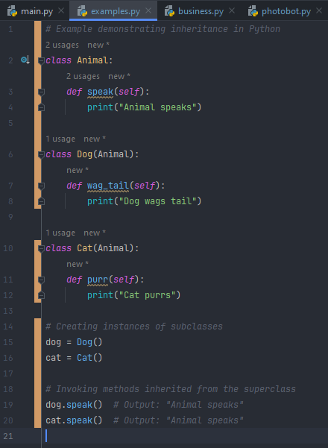
Inheritance
Inheritance Explanation:
In the example, we define a superclass Animal with a speak() method and subclasses Dog and Cat that inherit from Animal.
The subclasses Dog and Cat extend the functionality of the Animal superclass by adding new methods (wag_tail() and purr()).
Instances of the subclasses (dog and cat) inherit the speak() method from the Animal superclass, demonstrating the concept of inheritance in Python.
Inheritance is a fundamental concept in object-oriented programming that allows a class (subclass) to inherit properties and behaviors from another class (superclass).
In Python, subclassing and superclasses enable the implementation of inheritance, facilitating code reuse, and promoting a hierarchical structure of classes.
Subclassing:
Subclassing involves creating a new class (subclass) that inherits attributes and methods from an existing class (superclass).
The subclass can extend or modify the functionality of the superclass by adding new methods or overriding existing ones.
Superclasses:
Superclasses are the classes from which subclasses inherit properties and behaviors.
They serve as the blueprint or template for creating new subclasses with shared characteristics.

Slide 32
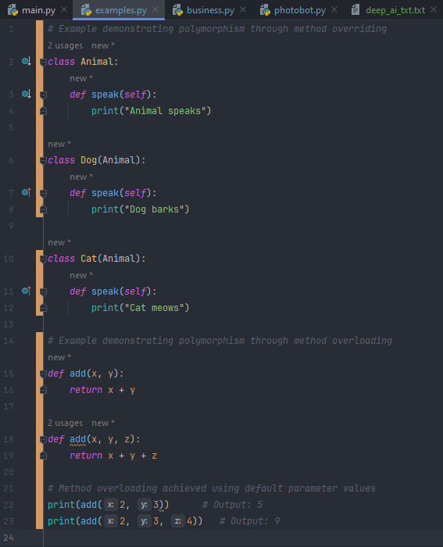
Polymorphism
Polymorphism Explanation:
In the first example, method overriding is demonstrated by defining a superclass Animal with a speak() method and subclasses Dog and Cat that override the speak() method with their specific implementations
In the second example, method overloading is simulated by defining multiple functions with the same name add() but different numbers of parameters
Polymorphism is a key concept in object-oriented programming that allows objects of different classes to be treated as objects of a common superclass.
In Python, polymorphism is achieved through method overriding and method overloading, which enable objects to exhibit different behaviors based on their specific implementations.
Method Overriding:
Method overriding occurs when a subclass provides a specific implementation of a method that is already defined in its superclass.
The overridden method in the subclass is invoked instead of the superclass method when called on objects of the subclass.
Method Overloading:
Method overloading allows multiple methods with the same name but different parameters or argument types to coexist within a class.
Python does not natively support method overloading, but it can be achieved using default parameter values or variable-length argument lists.

Slide 33
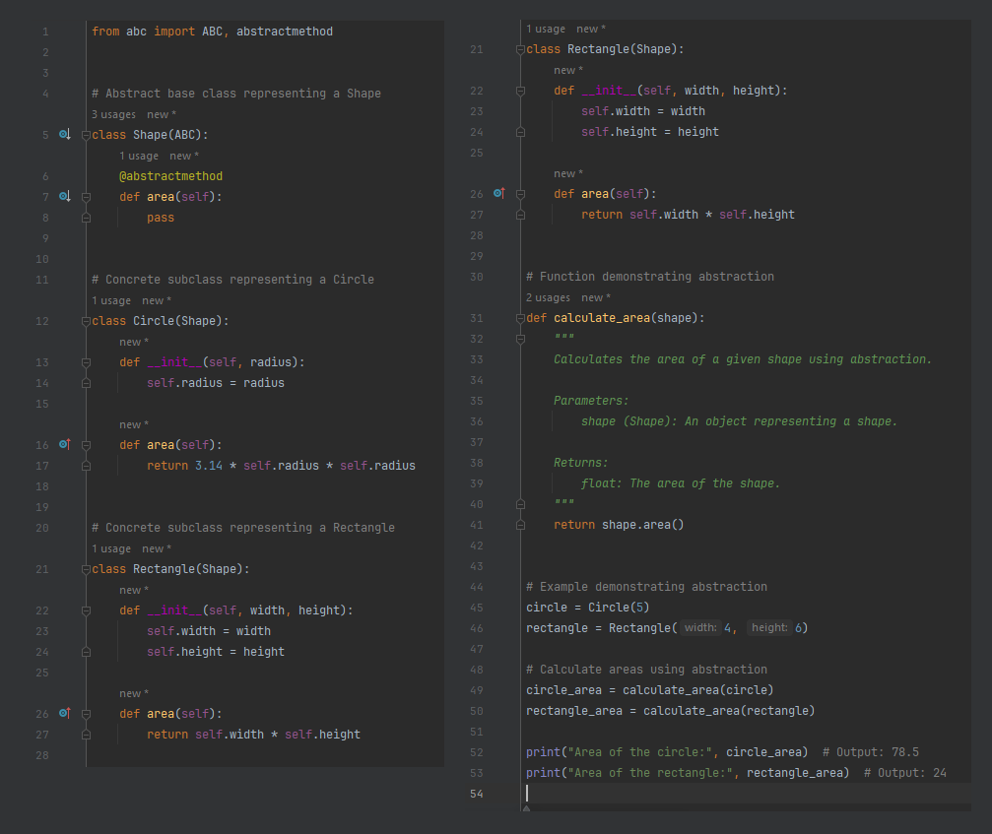
Abstraction
Abstraction is a key concept in object-oriented programming that allows us to hide complex implementation details behind a simplified interface.
In this example, we define an abstract base class Shape representing geometric shapes and an abstract method area() to calculate the area of a shape.
We then define concrete subclasses Circle and Rectangle that inherit from Shape and provide implementations for the area() method.
Finally, we demonstrate abstraction by creating instances of Circle and Rectangle objects and calculating their areas using the calculate_area() function without needing to know the specific implementation details of each shape.

Slide 34
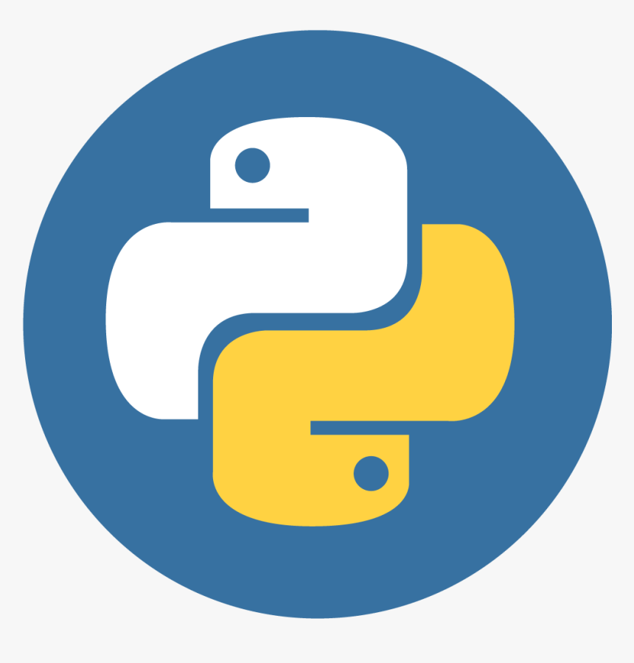
Conclusion
Throughout this presentation, we've explored the fundamental concepts and features of Python programming, ranging from data types and functions to object-oriented programming principles.
Python's versatility, simplicity, and extensive ecosystem of libraries and frameworks make it a popular choice for a wide range of applications, including web development, data analysis, machine learning, and more.
Whether you're a beginner embarking on your coding journey or a seasoned professional seeking to expand your expertise, Python offers endless opportunities for learning, growth, and creativity.

